Slide 1
Forecasting Project Cost Variance and Identifying Project Success Factors
Team 3
Capstone Project

Slide 2
Introduction
The project aims to improve management strategies by analyzing past data, using predictive models, and identifying key success factors for reliable cost estimates and insights.
The project focuses on accurately estimating costs and pinpointing factors for success.
Notes:
Our project is about predicting project costs correctly and finding out what makes a project successful. We looked back at old data, used forecasting tricks like predictive modeling, and figured out the most important things that led to success. This way, we aim to make managing projects better by giving trustworthy cost guesses and future insights.

Slide 3
Roles and Responsibilities
Amankumar Bhatu – Data Analyst
Kathan Patel - ML engineer
Rishabh Panchal - Data analyst
Rohan Mistry - Project manager
Tanay Shah - ML engineer

Slide 4
Objectives
Improving Cost Predictions
Forecasting Succes
Finding Key Success Factors
Notes:
Objective
Improved Cost Estimates: We put together a detailed plan to estimate project costs more accurately by learning from past projects and using smart tools.
Identified Success Factors: We used smart methods to figure out what will make projects successful, helping us plan better for the future.
Found Key Elements: We discovered the key things that really helped projects succeed, so we could focus on those.

Slide 5
Why this Project is helpful to the Client
Alignment with Client's Needs
Leveraging Machine Learning
Actionable Insights
Enhanced Project Management
Notes:
Why This Project Benefits the Client
Meeting the Client's Needs: Our project's goals aligns with what the client wanted—a strong plan for managing projects that are on time, within budget, and exactly what was planned.
Using Smart Tech: We used several machine learning models, like Linear Regression, Random Forest, and MLP Regressor, to analyze and predict project variables.
Insights You Can Use: We gave the client useful insights through Power BI, based on our machine learning analysis. This helps them get better at managing project costs and predicting if a project will succeed.
Better at Managing Projects: This led to the client getting better at overseeing projects, making smarter choices, and achieving better results.

Slide 6
Project Management Success Factors
Project success, as measured by the Iron Triangle
Scope: Achieving project objectives without significant scope changes.
Time: Completing the project within the planned timeline.
Cost: Staying within the allocated budget.
Balancing these constraints ensures project success.
Notes:
Project Management Success Factors
Project management is all about leading a team to hit specific targets in a set amount of time. It involves starting, planning, doing, keeping on track, and wrapping up the project.
Now, let's look at how we traditionally define project success. We use a concept called the Iron Triangle.
First up is scope. This is about what the project aims to do. Being successful here means hitting those targets without major changes.
Then there's time. This means finishing the project when we said we would. Sticking to deadlines is key for success.
And lastly, cost. We need to keep spending within our budget. Keeping costs under control is important for the financial side of success.
Getting the balance right among these factors is crucial. When we do, we make sure the project succeeds.

Slide 7
Methodology & Overview of Approach
Examined Success Factors: Looked into what makes project management work well, aiming to predict how costs might change and if projects will succeed.
Studied a Dataset: Checked out a lot of information that covered different types of projects, how companies are set up, the kinds of work they do, and how important each project was
Notes:
"We wanted to understand what makes some projects go really well. So, we looked into a lot of details from different kinds of projects and companies. We tried to see if we could make prediction how much things would cost and if the projects would be successful. This wasn't just about counting things; it was about understanding how companies work, the different jobs they do, and which projects they think are really important."

Slide 8
Technologies
Python -Data Analysis and Machine Learning
PoWer BI Visualization Tools
Jira for project managemnet
Notes:
Data Analysis and Machine Learning: Leveraged tools like Python with libraries such as Scikit-learn for machine learning model implementation and evaluation.
Visualization Tools: Used for generating graphs and charts to represent data insights and model accuracies, facilitating better understanding and decision-making. That would be further explain deeply by rishab
We utilized Jira for outlining project milestones and managing our timeline, which supported organized progress tracking and streamlined task coordination.
We assigned roles and responsibilities through Jira, creating a clear structure within our team. Regular updates ensured that project planning and scheduling were current, enhancing overall project management efficiency.
further will we deep dive into the mdeling process in detail which will be explained by kathan who worked in ML model

Slide 9
Tools, Techniques and Methodologies
Data Analytics: Used Power BI software to analyze key project variables like 'Effort Cost', 'Actuals', and 'Capacity to Deliver'.
Machine Learning Models: Employed Linear Regression, Random Forest, and MLP Regressor, optimized for accuracy through hyperparameter tuning.
Evaluation-Employed Mean Squared Error (MSE) and Root Mean Square Error (RMSE) to assess model performance.
Notes:
In this section, we used sophisticated tools for managing and analyzing data, focusing on important factors such as the cost of effort, real outcomes, and delivery capability. We also used machine learning techniques like Linear Regression, Random Forest, and MLP Regressor to predict the costs and success of projects, making sure to fine-tune these models for the best results. To understand how well our models are working, we looked at their Mean Squared Error (MSE) and Root Mean Square Error (RMSE), which help us make sure we're on the right track.
Lesser the MSE and RMSE that means the model is performing good

Slide 10
Project Timeline & Milestones
Data Collection and Preprocessing: Focused on dataset arrangement and cleaning in the initial weeks.
Model Development: Weeks 3-4 were dedicated to the development and preliminary testing of Linear Regression and Random Forest models.
Model Refinement: Intensive model optimization and hyperparameter adjustments took place in weeks 5-6.
Analysis and Insights:evaluated our predictive models and extracted crucial insights. Utilizing Power BI, we analyzed project performances, distinguishing between successful projects and those falling short.
Dashboard Creation: Following model refinement, we developed a dashboard in Power BI to visualize our data and findings, making the insights accessible and understandable to all stakeholders.
Notes:
In the initial stages of our project, we concentrated on organizing and cleaning our datasets to ensure a solid foundation for our analysis. This groundwork was critical for the success of the subsequent stages.
During weeks 3 and 4, we shifted our focus to the development and initial testing of our Linear Regression and Random Forest models. This phase was crucial for establishing a baseline for our predictive capabilities.
As we moved into weeks 5 and 6, we engaged in intensive optimization of our models, fine-tuning them through hyperparameter adjustments. This refinement process was aimed at enhancing the accuracy and reliability of our predictions.
In the final phase, we conducted thorough evaluations of our models to assess their performance. This culminated in the derivation of valuable insights, which informed our strategic decisions and contributed to a deeper understanding of the project dynamics.

Slide 11
Flow of Modelling process
Original Dataset
Preprocess Data
Training Data
Train ML Model
Original Dataset
Preprocess Data
Test Data
Trained ML Model
Model Predictions
Notes:
Start with the Original Dataset: This is we raw data, the information you'll use to teach your model.
Preprocess the Data: Here, we clean and organize your data. This step might involve normalizing or scaling the data, handling missing values, encoding categorical variables, and possibly selecting features.
Split the Data:
Training Data: A portion of our preprocessed data is used to train the model. The model learns from this data.
Test Data: Another portion is set aside to test the model. This is data the model has never seen before, used to check how well it has learned.
Train the ML Model: Using the training data, the model learns to make predictions or classify data points.
Trained ML Model: After training, you have a model that's ready to make predictions.
Model Predictions: Finally, you use your test data to see how well your model performs. This step gives you an idea of how the model might perform in the real world.

Slide 12
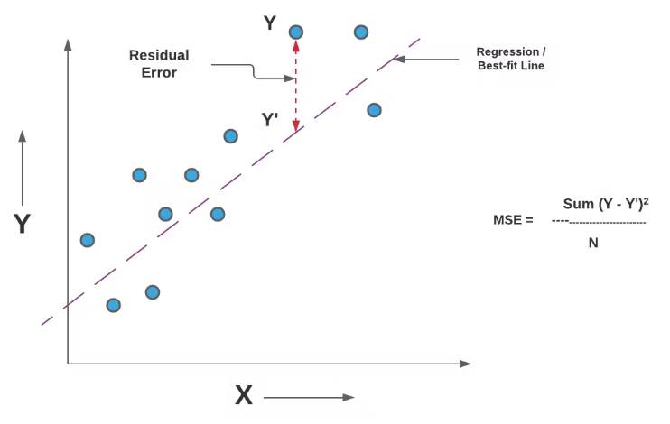
Evaluation Matrix
MSE(Mean Squared Error)
(Predicated value – Actual Value)^2
Lower is better

Slide 13
Preprocessing Techniques
Preprocessed Data
Standardized
Data
PCA
Data
Consistent Format
Improved Compatibility
Std:1 & Mean:0
Dimensionality Reduction
Feature Extraction
Notes:
Start with the Original Dataset: This is we raw data, the information you'll use to teach your model.
Preprocess the Data: Here, we clean and organize your data. This step might involve normalizing or scaling the data, handling missing values, encoding categorical variables, and possibly selecting features.
Split the Data:
Training Data: A portion of our preprocessed data is used to train the model. The model learns from this data.
Test Data: Another portion is set aside to test the model. This is data the model has never seen before, used to check how well it has learned.
Train the ML Model: Using the training data, the model learns to make predictions or classify data points.
Trained ML Model: After training, you have a model that's ready to make predictions.
Model Predictions: Finally, you use your test data to see how well your model performs. This step gives you an idea of how the model might perform in the real world.

Slide 14
Models Considered
Preprocessed Data
Linear
Regression
Random Forest Regressor
MLP Regressor
Standardized
Data
Random Forest Regressor
Random Forest Regressor
MLP Regressor
Linear
Regression
Grid Search CV
Grid Search CV
Linear
Regression
Random Forest Regressor
PCA
Data
Notes:
Start with the Original Dataset: This is we raw data, the information you'll use to teach your model.
Preprocess the Data: Here, we clean and organize your data. This step might involve normalizing or scaling the data, handling missing values, encoding categorical variables, and possibly selecting features.
Split the Data:
Training Data: A portion of our preprocessed data is used to train the model. The model learns from this data.
Test Data: Another portion is set aside to test the model. This is data the model has never seen before, used to check how well it has learned.
Train the ML Model: Using the training data, the model learns to make predictions or classify data points.
Trained ML Model: After training, you have a model that's ready to make predictions.
Model Predictions: Finally, you use your test data to see how well your model performs. This step gives you an idea of how the model might perform in the real world.

Slide 15
Modeling Results Comparison
Model Applied | Data Format | Results(MSE)
Linear | Prepared Data | 4.4572e-20
Linear Regression | Standardized Data | 3.1999e-21
Linear Regression | Data with PCA | 51534722817.22
Random Forest | Prepared Data | 239592.65
Random Forest | Standardized Data | 191310.62
MLP Regressor | Standardized Data | 89.875

Slide 16
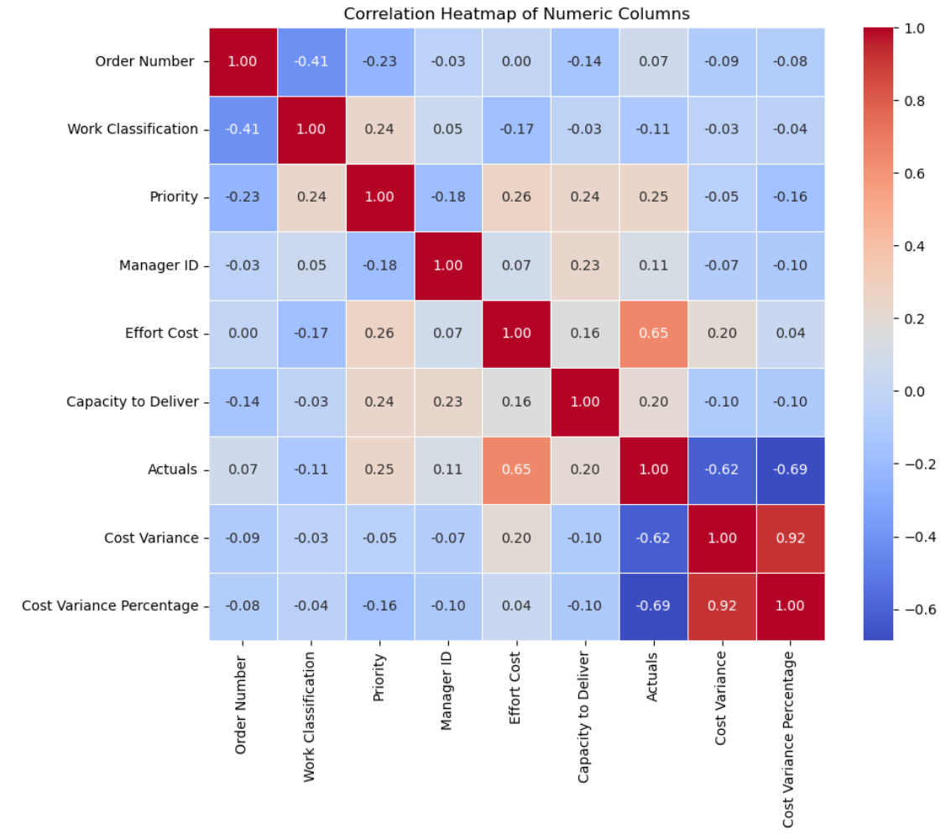
Analysis and Findings
Positive Relation:
'Effort Cost' & 'Actuals' (0.65)
'Priority' & 'Effort Cost' , 'Actuals' , 'Work Classification'. This suggests that the priority of the work assigned combined with type of work can impact the budgets.
'Manager' & 'Capacity to Deliver’. This suggests that Leadership and Team skillset may play a role in project's success and can be one of the factors for CV.
Negative Relation:
'Actuals' & 'Cost Variance' are inversely corelated, This suggests that if Actuals go up Cost Variance will go down (Negative CV is over budget).

Slide 17
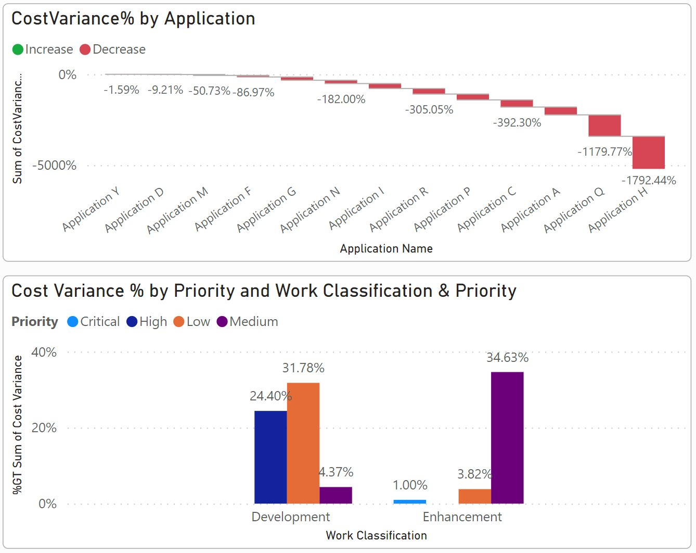
Analysis and Findings
'Priority'
Based on the analysis on the dataset, Priority affects CV the most.
'Low' & 'Medium' Priority Projects tend to go over budget.
‘Critical' Priority projects tend to be under budget or just a little over budget.

Slide 18
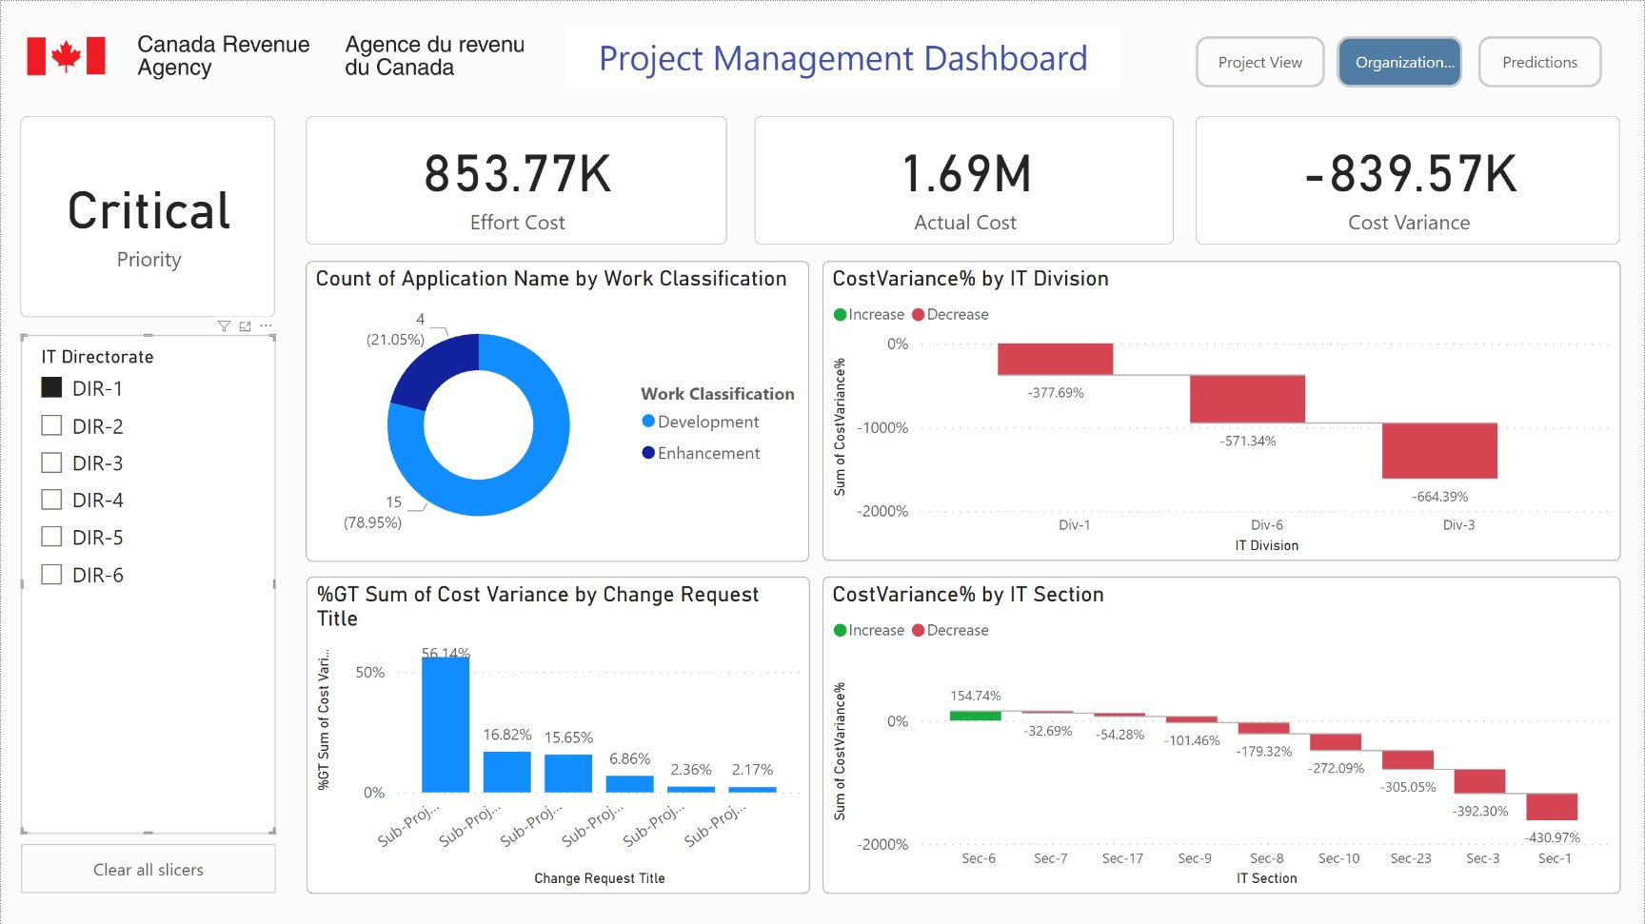
Analysis and Findings
Organization' (IT Dir, IT Div, IT Sec)
Based on the analysis, we can see that 'IT DIR-1' has a track record of going over budget in most of projects
'IT DIR-3' & 'IT DIR-6' has kept all their projects under budget.

Slide 19
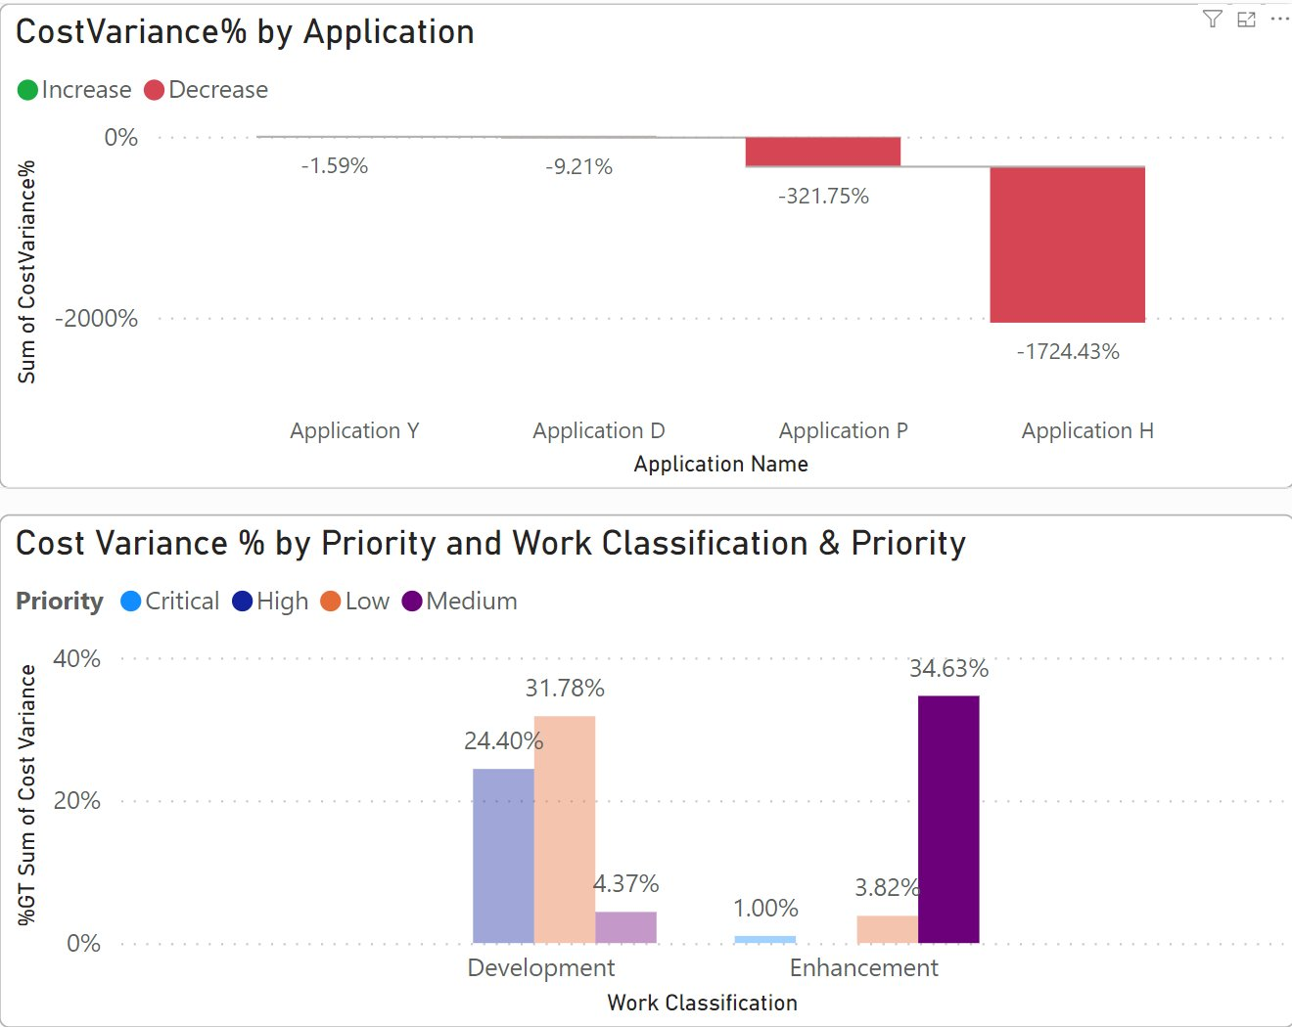
Analysis and Findings
'Work Classification'
Based on the analysis, CV doesn’t highly relate to Work Classification but there are some projects of 'Enhancement' which has the highest CV across all projects.

Slide 20
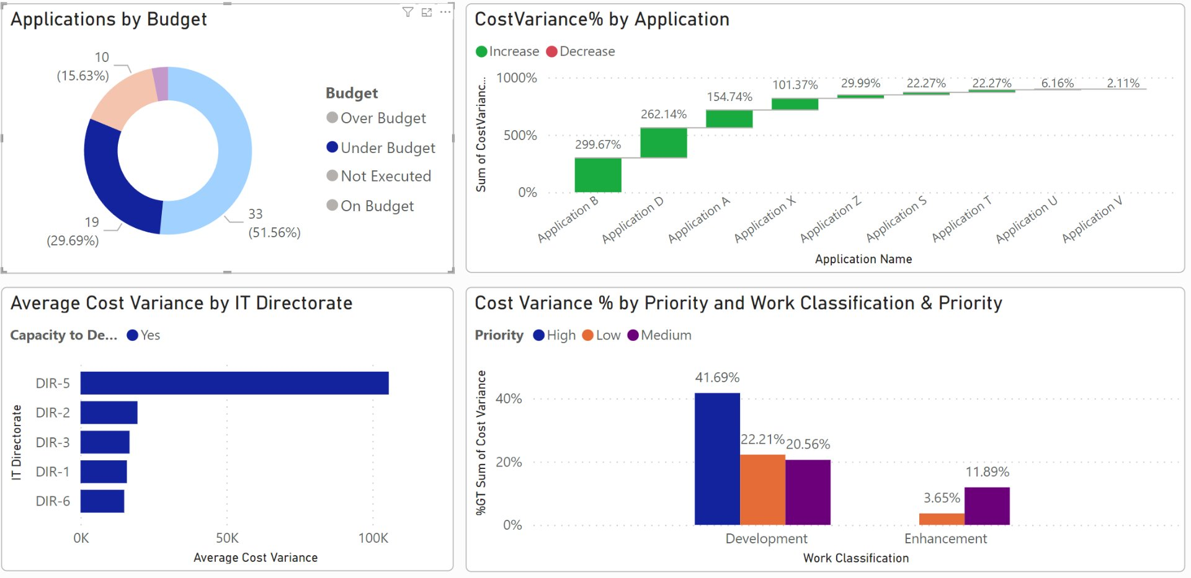
Analysis and Findings
Which Projects are 'Under Budget’ and are being successfully delivered.
Based on the dataset analysis, factors like 'Priority', 'Work Classification' and 'IT DIR' (Team) affect mostly for a project to be under budget.

Slide 21
Literature Review on Factors to be considered for Accurate Prediction of Project Success
Title – A machine learning study to improve the reliability of project cost estimates [1]
Focus on EV, AC, BAC to predict EAC
Feature introduction of Tracking period (Binning the values of project completion percentage)
XG Boost Model results were better as it can effectively handle input features of various datatypes and we can control parameters of models to produce accurate results.
1-30% - Initial Stage, 31-70% - Middle Stage, 71-95% - Late Stage
Notes:
Factors to be considered which helps make accurate predictions of project costs.
Talks about earned value, actual value and budget at completion values to predict estimate at completion.
Noteworthy feature that was added is Tracking period – Categorical feature And create separate models for each phase which helps project managers make decision at each stage with accurate results.

Slide 22
Literature Review on Factors to be considered for Accurate Prediction of Project Success
Title - A construction cost estimation framework using DNN and validation unit. [2]
A model which uses Deep Neural Network introduced a variable related to risk
As an introductory feature, some qualitative risk variables such as (probability*severity) score for each sub-project can be introduced.
Moreover, number of change requests applied/approved can be introduced as well which can help model understand impact of these factors on project success.
Variable related to number of risks triggered during project phase.
Notes:
Noteworthy thing – Introduction of features related to risk.
As an introductory variable some qualitative risk factor such as (probability*severity) score can be added at each subproject level.
Another variable is number of change requests made/approved for each project can be included as we know that higher the number of changes made to a project higher the risk of project failure.
Last feature is number of risks triggered during the project phase.

Slide 23
Literature Review on Factors to be considered for Accurate Prediction of Project Success
Title: Application of Machine Learning to Limited Dataset: Prediction of Project Success [3]
Feature related to frequency of communication of objectives and goals to team members
Feature related to completeness of understanding of objectives and goals by the team members
Feature related to buy-in level of project team members towards objectives/goals
Feature related to adequate training of the project team including managers
Variable measuring adequateness of processes required in the project/sub-project (Introductory variable - Yes/No)

Slide 24
Conclusion
Project success prediction based on cost alone has limited value. Better predictions can be made with addition of extra features.
Simple prediction models like Linear Regression perform better than complex prediction models like Neural Networks when cost factor is involved.
Priority and Organizational structure has some influence over the projects being over budget.

Slide 25
Recommendations and Future Work
Root Cause Analysis for over-budget reasons should be performed for projects with Priority “Medium” and “Low”, followed by solution preparation of causes identified based on Pareto principle.
Processes for estimation of “effort cost” should be revisited for improvement purpose.
For accurate predictions of cost variance, additional factors related to risks, training, communication, team engagement should be included.
Additional Machine Learnings models like XGBoost, Support Vector Machines should be tried and compared with previous results.

Slide 26
References
Timur Narbaev, Öncü Hazir, Balzhan Khamitova & Sayazhan Talgat (2023) A machine learning study to improve the reliability of project cost estimates, International Journal of Production Research, DOI: 10.1080/00207543.2023.2262051
Salman Saeidlou & Nikdokht Ghadiminia (2024) A construction cost estimation framework using DNN and validation unit, Building Research & Information, 52:1-2, 38-48, DOI: 10.1080/09613218.2023.2196388
Bang S, Aarvold M O, Hartvig W J, Olsson N O E, Rauzy A (2022). Application of machine learning to limited datasets: prediction of project success, ITcon Vol. 27, pg. 732-755, https://doi.org/10.36680/j.itcon.2022.036

Slide 27
THANK YOU
Questions?

